Slide 1
MongoDB vs PostgreSQL
A Detailed Comparison of MongoDB and PostgreSQL

Slide 2
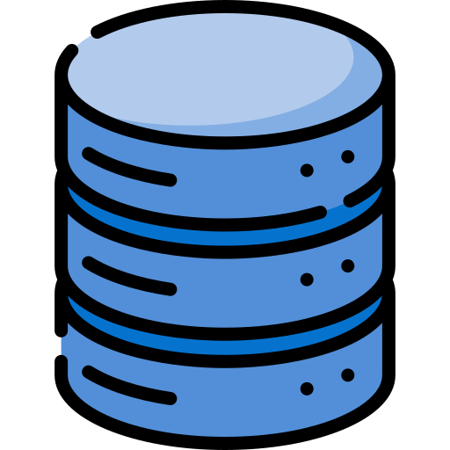
Data modeling
Scalability
Basic unit of storage
Availability
Indexing
Concurrency
Query language

Slide 3
Data modeling
Basic unit of storage
Scalability
Availability
Indexing
Concurrency
Query language

Slide 4
Data Modeling
 | MongoDB | PostgreSQL
Data model structure | Database Collections Documents Fields | Database Table Rows Columns

Slide 5
Key Differences Between MongoDB and PostgreSQL Data Types
Aspect | MongoDB | PostgreSQL
Schema Flexibility | Dynamic schema | Fixed schema
Arrays | Native support for arrays | Supports arrays, but!
Nested Data | Deeply nested documents. | Using JSON or JSONB columns.
Binary Data | BinData for binary data. | Uses BYTEA for binary data.
JSON Support | BSON with additional types. | Supports JSON and JSONB
Unique Identifiers | Uses ObjectId as a default unique ID | Uses UUID for unique identifiers.
Regular Expressions | Supports regular expressions as field types. | Regular expressions used within queries.
Custom Types | No native support for custom types. | Supports user-defined types.

Slide 6
Data modeling
Basic unit of storage
Scalability
Availability
Indexing
Concurrency
Query language

Slide 7
Indexing in MongoDB vs. PostgreSQL
Feature | MongoDB | PostgreSQL
Default Index | index on the _id field | B-tree index on the primary key.
Index Types | B-tree Compound Multikey Index Text Geospatial Hashed Wildcard Clustered | B-tree Hash Compound GIN (Generalized Inverted Index) GiST (Generalized Search Tree) Geospatial SP-GiST (Space-Partitioned GiST) BRIN (Block Range Index)
Compound Index | Supports compound indexes (multiple fields in one index). | Supports multi-column indexes.
Multikey Index | Supports multikey indexes for indexing arrays. | No direct equivalent for indexing arrays.

Slide 8
Table Column/Row Model

